Slide 1


◔
PRODUCTION LINE MAINTENANCE REPORT
⚿
CONFIDENTIAL — INTERNAL USE ONLY
⚡
BREAKDOWN ANALYSIS · 2026-08-17
◔
Line 103 Breakdown
Data Analysis Report — Descriptive · Diagnostic · Predictive · Prescriptive
103
726
450.4h
6.50h
3.69 /day
BREAKDOWN EVENTS
TOTAL DOWNTIME
AVG MTBF
BREAKDOWN FREQUENCY
Slip entries, Jan–Jul 2026
≈ 18.8 production days lost
A breakdown every ~6.5 hours
25.8 events per week
PREPARED BY MAINTENANCE ANALYTICS TEAM
DATA PERIOD 2026-01-16 → 2026-07-31 · 197 DAYS
Notes:
- Purpose: open with the four-pillar analytics framework — descriptive, diagnostic, predictive, prescriptive. - Call out the four headline KPIs: 726 events, 450.4 h downtime, 6.50 h MTBF, 3.69 breakdowns/day. - Frame this deck as decision-grade for plant leadership — anchored on numbers, not anecdotes. - Set expectation: data window is 197 days (Jan–Jul 2026), Mechanical & Pareto concentrations drive the story. - Transition: "Let's anchor on the at-a-glance KPIs and the five headline findings."

Slide 2

01 / EXECUTIVE SUMMARY
⚑
DECISION-GRADE
Line 103 — At a Glance
726 breakdown events across 197 days — mechanical faults dominate, a few machines drive most of the loss, and the trend is bending upward.
726
450.4 hr
!
TOP 5 FINDINGS
HEADLINE EVIDENCE
TOTAL BREAKDOWNS
TOTAL DOWNTIME
slip entries
≈ 18.8 prod days
01
Severe line instability
3.69 breakdowns/day, MTBF only 6.50 h, 76% of days had events.
02
Mechanical faults dominate
41.6 min
20 min
69.0% of events (501/726) and 59.3% of downtime (267.3 h).
AVG MTTR
MEDIAN MTTR
03
Pareto concentration
across non-zero
half repaired faster
Top 5 machines = 35.9% of events; OP-40 alone = 67 events / 36.3 h.
04
Planned Maintenance oversized
6.50 hr
75.6%
Only 3.6% of count but 15.5% of downtime (161 min/event avg).
AVG MTBF
DAYS WITH BREAKDOWNS
05
Negative trend
highly unstable
149 / 197 days
+0.204 events/week, projected ~29 events / 20.3 h by week +4.
LINE 103 BREAKDOWN ANALYSIS · REPORT DATE 2026-08-17
02 / 10
Notes:
- Anchor on MTBF = 6.50 h — the single most important number; line is highly unstable. - Mechanical faults are the #1 investment area: 69% of events, 59% of downtime. - Pareto concentration: top 5 machines = 35.9% of all events — focus investment here. - Planned Maintenance: a quick classification win — 161 min/event average signals mis-scoped work. - Trend trajectory sets up slide 7 forecast: ~29 events / 20.3 h per week by week +4.

Slide 3
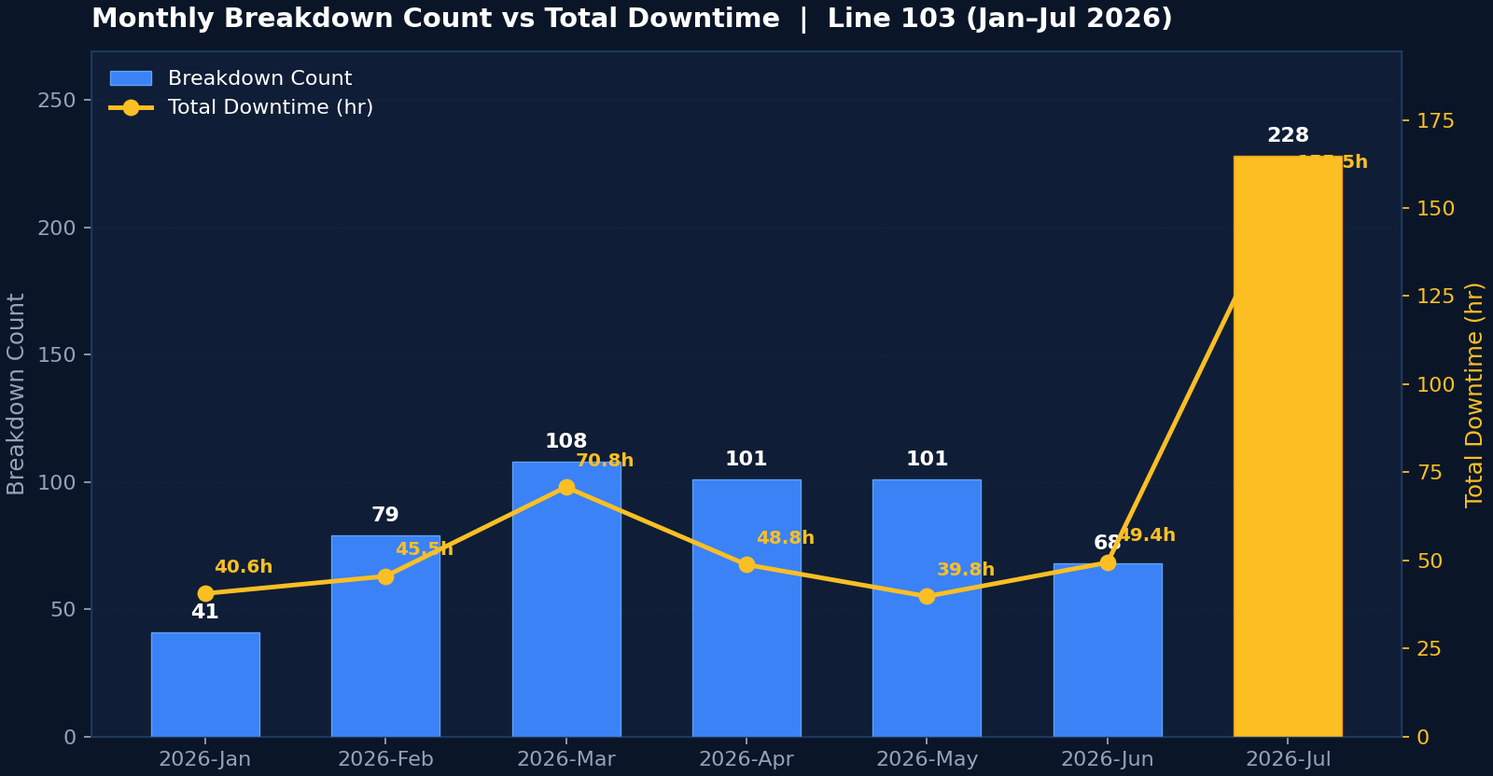
02 / DESCRIPTIVE ANALYTICS · TEMPORAL PATTERNS
Monthly Trends — Count vs Downtime
March and July were the worst months; lower-count months carried higher-severity events.
FIG. 1
Monthly Breakdown Count vs Total Downtime — Line 103 (Jan–Jul 2026)
KEY OBSERVATION
↗
Jul 2026 is the worst month by far: 228 events (3.1× the Jan baseline) and 155.5 h downtime. The line has been getting worse, not better, across the observation window.
SEVERITY INVERSE
→
In low-count months (Feb, May), avg duration per event climbs (34.6 / 23.6 min). Fewer events but bigger — characteristic of an unstable line where the occasional major fault drives the production loss.
DATA TABLE
JAN–JUL 2026
Month | Count | Downtime (hr)
Jan | 41 | 40.6
Feb | 79 | 45.5
Mar | 108 | 70.8
Apr | 101 | 48.8
May | 101 | 39.8
Jun | 68 | 49.4
Jul | 228 | 155.5
LINE 103 BREAKDOWN ANALYSIS · DESCRIPTIVE ANALYTICS
03 / 10
Notes:
- July is the spike month — 228 events and 155.5 h, ~3× the January baseline. - Count-vs-downtime asymmetry: low-count months (Feb, May) carry longer events — instability signature. - 7-day rolling average never dipped below 2 events/day across the entire window — chronic instability. - Links to forecast slide 7: trajectory continues upward without intervention.

Slide 4
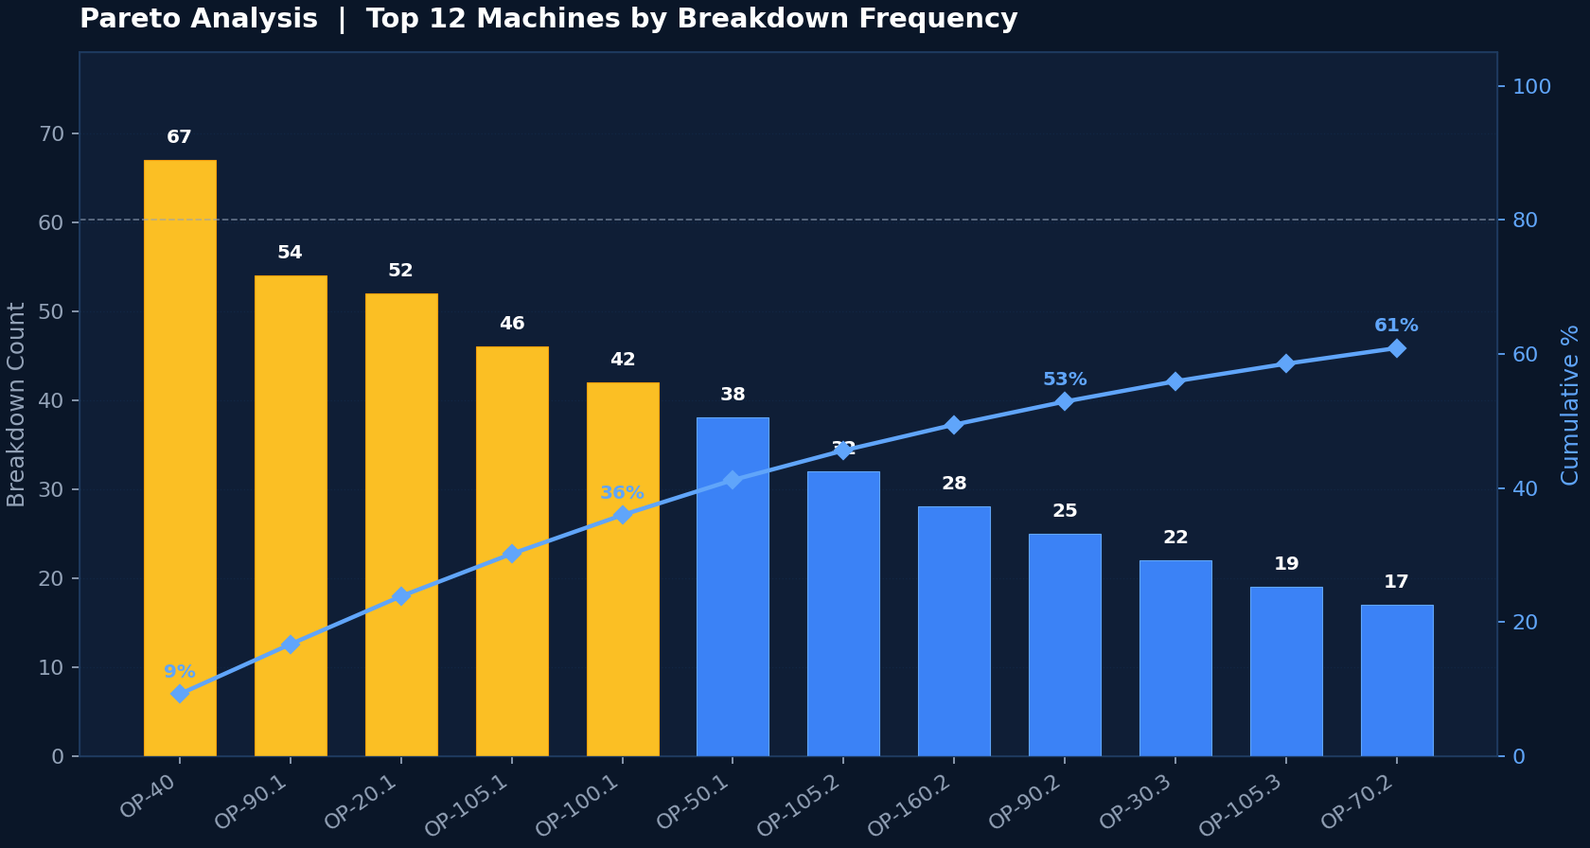
02 / DESCRIPTIVE ANALYTICS · MACHINE CONCENTRATION
Pareto — Top 12 Machines
Top 5 machines = 35.9% of all events · Top 12 = >70%. Concentrate reliability investment here.
FIG. 2
Pareto Analysis — Top 12 Machines by Breakdown Frequency
✦
TOP 5 OFFENDERS
BY EVENT COUNT
Machine | Events | Down (hr) | % Total
OP-40 | 67 | 36.3 | 9.2%
OP-90.1 | 54 | 34.0 | 16.7%
OP-20.1 | 52 | 26.4 | 23.8%
OP-105.1 | 46 | 31.2 | 30.2%
OP-100.1 | 42 | 22.7 | 36.0%
OP-40 alone = 9.2% of all breakdowns. Fixing this single station would yield disproportionate gains.
BY DOWNTIME
◔
OP-90.1 / OP-105.1 climb above OP-40.
Machines that fail often but are quick to fix are a different problem from machines that fail rarely but take long to fix.
LINE 103 BREAKDOWN ANALYSIS · DESCRIPTIVE ANALYTICS
04 / 10
Notes:
- OP-40 is the single biggest offender — 67 events, 36.3 h, 9.2% of all breakdowns. - Top 5 = 35.9%; Top 12 = >70% — classic Pareto concentration. - Pareto shifts when ranked by downtime — OP-90.1 and OP-105.1 climb above OP-40. - Sets up Action 8 (RCM pilot on top 5 stations) on slide 9.

Slide 5
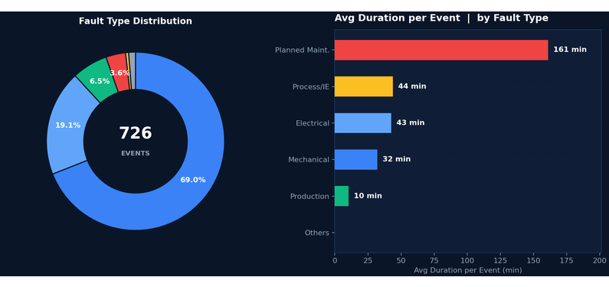
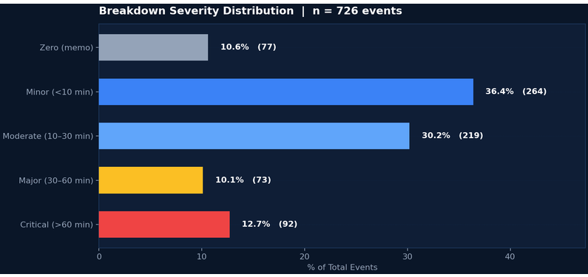
02 / DESCRIPTIVE ANALYTICS · FAULT TYPE & SEVERITY
Mechanical Dominance — 7 in 10 Breakdowns
Electrical events are rarer but take longer; Planned Maintenance is a hidden 15.5% downtime share.
FIG. 3 + FIG. 4
Fault Type Distribution & Avg Duration
FIG. 7
Breakdown Severity Distribution
Mechanical — 69%
Planned Maint. — 161 min/event
Critical Events — 12.7%
501 events · 267.3 h downtime · 32 min avg · max 1659 min. Primary failure surface — sensors, stoppers, cylinders, bits, knives, bowl feeders.
Only 26 events (3.6%) but 69.8 h (15.5%) downtime. Suggests scope creep or mis-classification of corrective work as planned.
92 events >60 min. Priority target for RCFA — each one represents a significant production stop. Drive the bulk of production loss.
LINE 103 BREAKDOWN ANALYSIS · REPORT DATE 2026-08-17
05 / 10
Notes:
Cue bullets: • Headline: 7 in 10 breakdowns are mechanical — 501 events, 267.3 h downtime. • Electrical events are rarer but take longer — 42.6 vs 32 min average. • Planned Maintenance: 161 min/event average — hidden 15.5% downtime share, red flag for mis-classification. • Severity tail (Major + Critical ≈ 23%) drives most of the loss — 92 events over 60 min. • Sets up Action 5 on slide 9 — re-scope and re-classify planned maintenance.

Slide 6
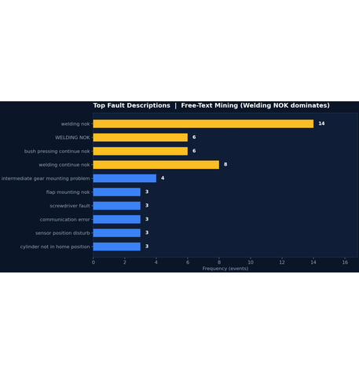
03 / DIAGNOSTIC ANALYTICS · ROOT CAUSES
Why It Is Happening — 5 Drivers
Cleaning/adjustment recurrence + consumable wear + sensor/pneumatic drift + quality stops + shift risk.
FIG. 9
Text-Mining Top 10
01 · LACK OF PM DISCIPLINE
02 · COMPONENT WEAR
03 · SENSOR & PNEUMATIC DRIFT
Reactive cleaning instead of preventive
Knives, bits, screw sleeves wearing untracked
Brackets loosen, air leaks creep in
Action field shows recurring phrases — clean mouth piece, set sensor, adjust stopper, reset MCB. Same machines, same actions, days apart. PM schedule is too infrequent or not executed as specified.
Screwdriver bits, knives, screw-holding sleeves repeatedly cleaned/replaced. 20–40 min diagnosis before replacement. No per-station cycle counter, no predictive replacement.
Sensor position disturb, cylinder not in home position, pallet cylinder air leakage. Recurrence within 1–2 weeks. No thread-lock / torque verification / air-leak audit routine.
04 · PROCESS / QUALITY STOPS
05 · SHIFT-SPECIFIC RISK
TRANSITION
Shift C (night) carries highest load
5 Drivers → 8 Actions
Bowl-feeder / component-quality issues upstream
Each driver maps to specific actions on the slide 9 roadmap — A1 PM checklist, A2 cycle-counters, A4 pneumatic audit, A6 night-shift study.
C > B > A. Drivers: reduced night support, accumulated drift by end of 24-h cycle, product-mix / rate differences, fatigue. Recommend 2-week focused night-shift study.
47 Production-tagged events. NOK / continue NOK / inserting problem. Root cause is upstream — component quality, feeder setting, operator handling. Production-eng intervention, not maintenance.
WELDING NOK cluster on OP-90.x dominates the free-text mining — a process-welding reliability gap.
LINE 103 BREAKDOWN ANALYSIS · REPORT DATE 2026-08-17
06 / 10
Notes:
Cue bullets: • Driver 1 — PM discipline: highest-leverage opportunity; recurring action phrases prove PM is reactive. • Driver 2 — Component wear: easiest fix — add per-station cycle counters, replace at 80% wear life. • Driver 3 — Sensor/pneumatic drift: structural fix — torque verify, thread-lock, scheduled air-leak audit. • Driver 4 — Quality stops: production-eng problem, not maintenance — 47 Production-tagged events. • Driver 5 — Night shift: mysterious — recommend a 2-week focused Shift C study. • Transition: these five drivers translate directly into the 8-action plan on slide 9.

Slide 7
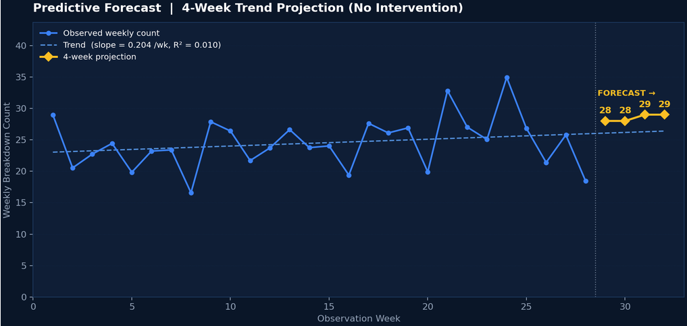
04 / PREDICTIVE ANALYTICS · 4-WEEK PROJECTION
Where This Is Heading
Trend slope +0.204 events/week · downtime slope +0.264 h/week · annualised cost of inaction ≈ 1,341 events / 835 h / 35 prod-days lost.
FIG. 12
Weekly Breakdown Count + 4-Week Projection
PROJECTED — NO INTERVENTION
W +1 → W +4
Week | Events | Downtime (hr)
Week +1 | 28 | 19.5
Week +2 | 28 | 19.8
Week +3 | 29 | 20.0
Week +4 | 29 | 20.3
ANNUALISED COST OF INACTION
Extrapolating the current trajectory: ≈1,341 breakdowns and ≈835 downtime hours per year — equivalent to 35 production days lost annually.
WHAT THIS MEANS
Intentionally simple (linear on weekly aggregates, R² = 0.010). Treat as directional guidance, not precision. The value is to quantify the cost of inaction to unblock investment approval.
LINE 103 BREAKDOWN ANALYSIS · REPORT DATE 2026-08-17
07 / 10
Notes:
Cue bullets: • Week +4 projection: 29 events / 20.3 h downtime per week — the trajectory keeps climbing. • Annualised cost of inaction: ≈1,341 breakdowns / 835 h / 35 production days lost per year. • Acknowledge low R² (0.010) — forecast is directional, not precision; treat as a guidance lever. • Use this slide as the urgency lever to unblock investment approval for the slide 9 action plan.

Slide 8
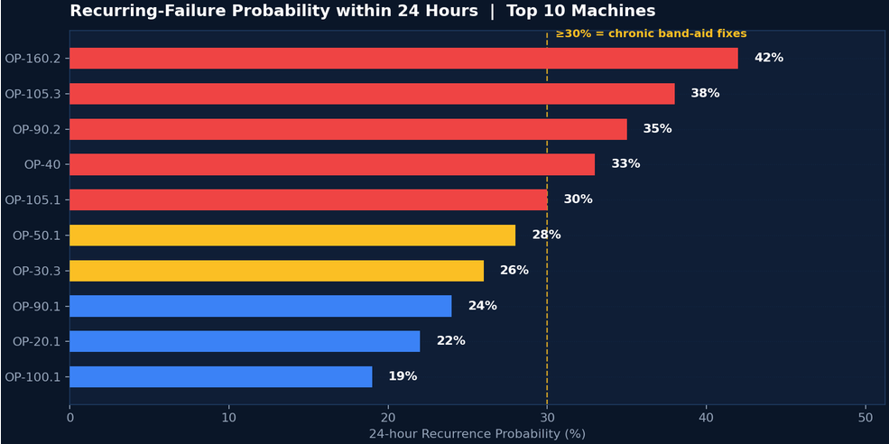
04 / PREDICTIVE ANALYTICS · RECURRENCE
Same-Machine Recurrence — Band-Aid Fixes
Machines with 24-hour recurrence ≥ 30% are chronic band-aid candidates. Symptom cleared, root cause not fixed.
FIG. 13
RECURRENCE 24H — TOP 10 MACHINES
RED ZONE — ≥30% RECURRENCE
!
Machine | Recurrence | Action
OP-160.2 | 42% | P2 RCFA
OP-105.3 | 38% | P2 RCFA
OP-90.2 | 35% | P2 RCFA
OP-40 | 33% | P1 PM Checklist
OP-105.1 | 30% | P2 RCFA
WHAT RECURRENCE MEANS
High recurrence = technician cleared the symptom ("set the sensor and trial taken ok") but not the underlying drift mechanism — same fault returns shortly after. Best leading indicator of incomplete root-cause fixing.
SCENARIO IMPLICATIONS
Scenario | Impact
Baseline (no action) | 29 ev / 20.3h by W+4
Targeted PM (90%) | −25–35% minor+moderate
Cycle-counter replace | −40–60 wear/qtr
08 / 10
Notes:
- Recurrence rate is the leading indicator — more diagnostic than raw event count. - Red-zone machines (OP-160.2, OP-105.3, OP-90.2, OP-40, OP-105.1) become the RCFA targets — Action 3 on slide 9. - Scenario table quantifies the leverage of the action plan — targeted PM alone cuts 25–35% in 8 weeks. - Transition phrase: "Now let's translate this into the 8-Action Roadmap."

Slide 9
05 / PRESCRIPTIVE ANALYTICS · ACTION PLAN
8-Action Roadmap — 3 Workstreams
Quick Wins (0–30d) stabilise · Structural (30–90d) builds capability · Strategic (90–180d) embeds system.
QUICK WINS · 0–30 DAYS
P1 / P2
STRUCTURAL · 30–90 DAYS
P2 / P3
STRATEGIC · 90–180 DAYS
P3
A1
P1
MECHANICAL FASTENING & PNEUMATIC AUDIT
P2
A7
P3
DAILY PM CHECKLIST (TOP 5)
A4
REAL-TIME OEE & DOWNTIME DASHBOARD
IMPACT HIGH · EFFORT LOW
IMPACT HIGH · EFFORT MED-HIGH
IMPACT HIGH · EFFORT HIGH
15-min daily checklist on OP-40 / 90.1 / 20.1 / 105.1 / 100.1. Mouth piece, vacuum filter, sensor position, stopper, bowl feeder. Audited daily for 4 weeks.
Line-wide torque verify + thread-lock + ultrasonic leak detection. ~$2,000 capex. Schedule on a PM weekend.
PLC-fed live dashboard: OEE, current MTBF, top fault code, machines in alarm, 7-day rolling trend. Eliminates manual CMMS work. 8–12 weeks engineering.
A2
CYCLE-COUNTER COMPONENT REPLACEMENT
P1
A5
RE-CLASSIFY & RESCOPE PLANNED MAINT.
P2
IMPACT HIGH · EFFORT MED
IMPACT MED · EFFORT LOW
A8
P3
Bits / knives / sealing sleeves on OP-90.1, OP-105.1 / 2 / 3, OP-70.2, OP-50.1, OP-160.2. Replace at 80% of documented wear life.
Audit 26 planned-maint events (avg 161 min). Reclassify mis-tagged corrective work. Target avg <90 min, downtime share <8%.
RCM PILOT ON TOP 5 MACHINES
IMPACT HIGH · EFFORT HIGH
Formal RCM study on OP-40 / 90.1 / 20.1 / 105.1 / 100.1. Failure-mode register + evidence-based maintenance plan. Template for line-wide rollout.
A3
P2
A6
P3
RECURRENCE HOT-SPOT RCFA
NIGHT-SHIFT RELIABILITY STUDY
IMPACT MED · EFFORT LOW
IMPACT MED · EFFORT MED
Top 3 machines from Fig 13 with ≥30% recurrence. 5-Why / fishbone. 8-week recurrence tracking post-fix.
2-week focused study on Shift C. Senior technician logs 30-sec RC first impression, audits handover condition, compares product mix.
↗
PILOT SUCCESS
Roll out RCM across the full line over the following 6 months.
09 / 10
Notes:
- A1 + A2 are the highest-ROI Quick Wins — start in week 1. - A3 RCFA is cheap leverage on chronic repeat-failures (red-zone machines from slide 8). - A4 pneumatic audit is the structural backbone fix — only ~$2k capex. - A7 dashboard eliminates the manual-data-quality tax surfaced in slide 5. - A8 RCM pilot is the systemic play; success template rolls out line-wide. - Total capex ~$2k — most actions are labour-only. Transition: "Slide 10 is the decision ask."

Slide 10
06 / NEXT STEPS · DECISION ASK
From Report to Loop — Validation Cadence
Convert this one-time report into a 4-cadence continuous improvement rhythm.
VALIDATION CADENCE
4-LEVEL REVIEW LOOP
DECISIONS REQUESTED TODAY
⚖
APPROVE A1 + A2 (Quick Wins) for immediate execution — 0–30 days.
APPROVE A4 mechanical & pneumatic audit capex (~$2,000) on next PM weekend.
ASSIGN owner for A6 night-shift 2-week study (start within 14 days).
SPONSOR A7 OEE dashboard initiative — cross-functional (Maintenance + IT + Production).
· FIRST 8 WEEKS
▦
WEEKLY
Refresh daily trend chart (Fig 8) + top-5 machine count. Compare to 4-week pre-intervention baseline. Flag any divergence > 20% to maintenance leadership.
MONTHLY
▦
Refresh full descriptive analytics (Sec 4) + recurrence probability (Fig 13). Verify P1-target machine recurrence trending downward.
RISKS OF INACTION
⚠
QUARTERLY
▦
Without intervention, the line is projected to add ~29 events / 20.3 h downtime per week, with upward drift. Annualised: ≈1,341 events / 835 h / 35 production days lost.
Refresh full report incl. diagnostic, predictive, prescriptive. Retire completed actions, escalate stalled ones, add newly identified opportunities.
PREPARED BY MAINTENANCE ANALYTICS TEAM · REPORT REF: LINE103-BAR-20260817
COMPANION FILES: cleaned_breakdown_data.csv · analysis_summary.xlsx · charts/
ANNUALLY
♛
Full reliability review with cross-functional leadership. Cumulative dataset — long-term trends, seasonality, structural-fix impact assessment.
10 / 10
Notes:
- Frame the 4-cadence loop as the mechanism that turns the report into continuous improvement. - Name the 4 explicit decisions requested today: A1+A2, A4 capex, A6 owner, A7 sponsor. - Anchor the cost of inaction back to slide 7 — 35 production days lost per year. - Thank leadership for their time and invite Q&A. - Close with: "Decisions on A1, A2, A4, A6 can start within 14 days — that's the unlock."

